Slide 1

I am tasteless.
I am colorless.
I am shapeless.
I am odourless.
But without me, there is no life.
Can you tell me who am I??????

Slide 2

Water cycle

Slide 3
Water cycle
Evaporation
Condensation
Precipitation
Accumulation

Slide 4
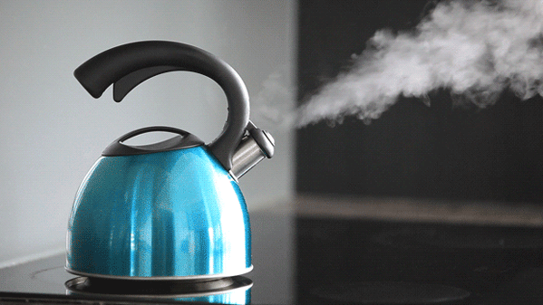
Evaporation is a process by which water gets converted from a liquid form to vapor form.

Slide 5
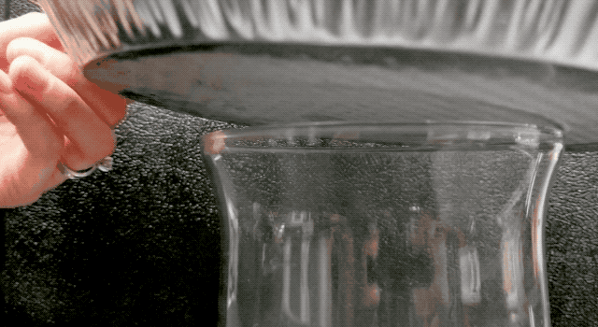
Condensation is the process by which water vapor turns into liquid.

Slide 6
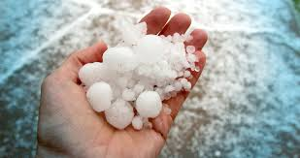
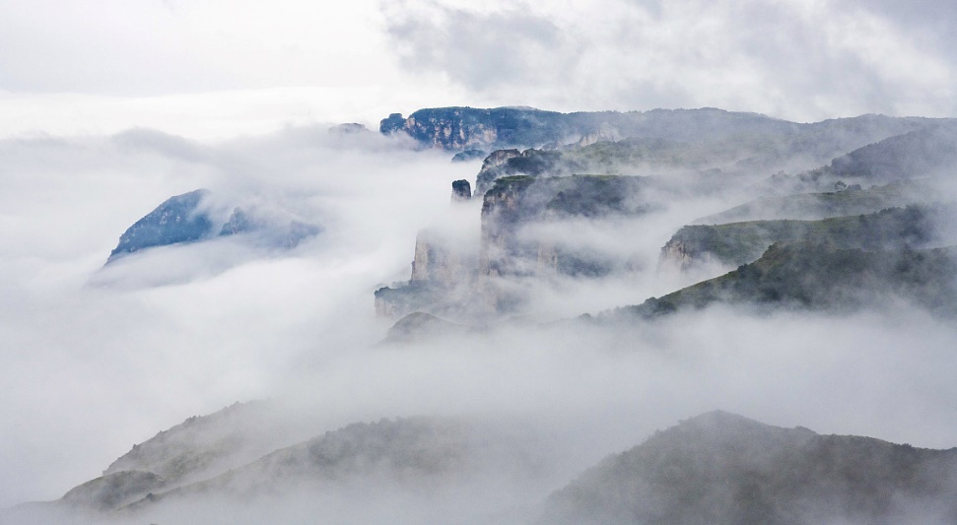
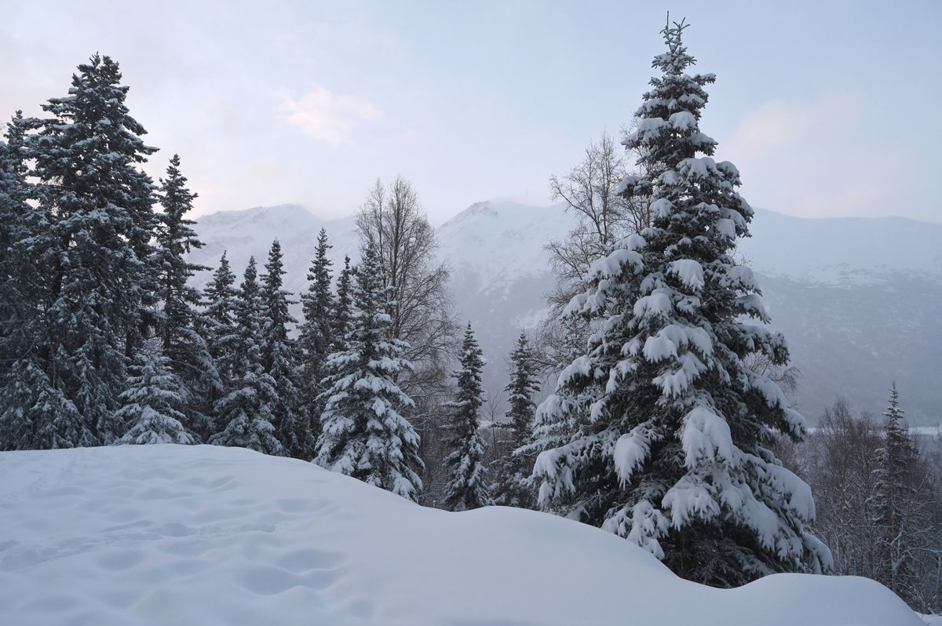
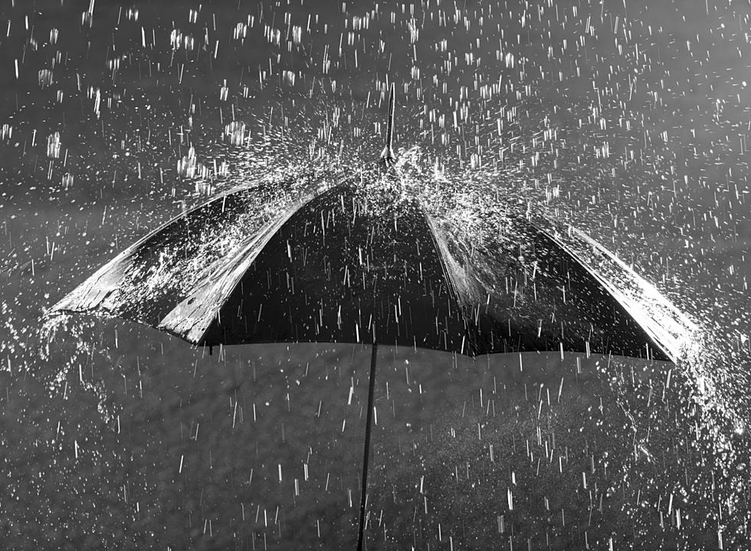
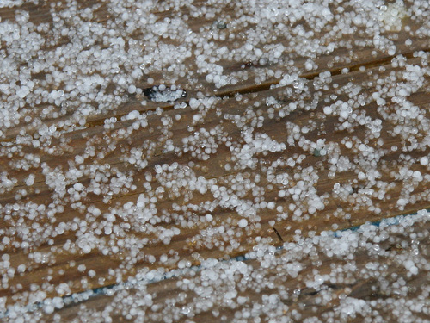
hail
mist
snow
rain
sleet
Precipitation - water that falls to the earth as hail, mist, rain, sleet, or snow.

Slide 7
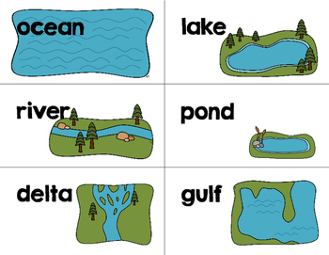
Accumulation is the process of water collecting in rivers, lakes, streams, oceans and other bodies of water.

Slide 8

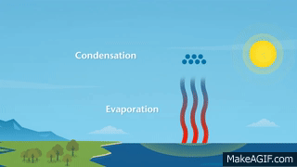
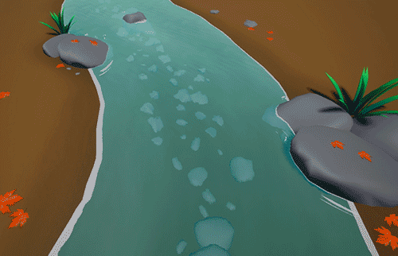
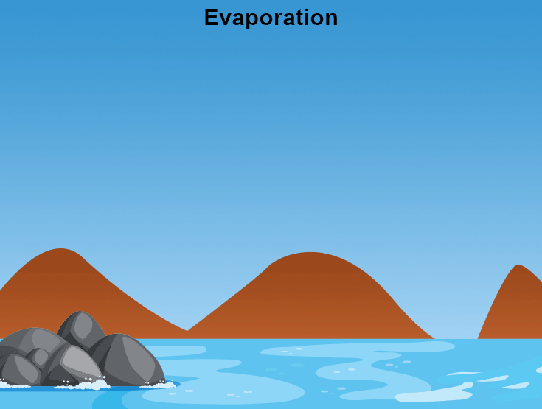
Precipitation
Condensation
Water cycle
Accumulation
Evaporation

Slide 9
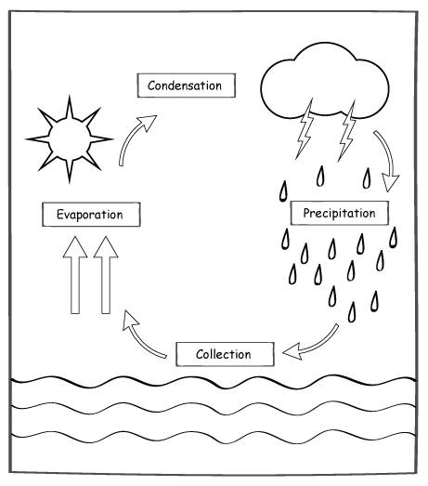
Homework
Draw this picture in notebook and colour it.

